Slide 1
Software & Hardware

Slide 2
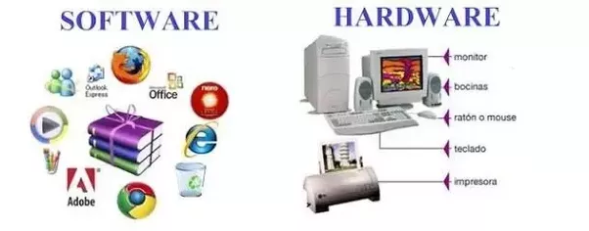

Slide 3
What is software?
Sometimes abbreviated as SW and S/W
Software is a collection of instructions that enable the user to interact with a computer, its hardware, or perform tasks.
Computer is useless without software
E.g. without internet browser will not browse anything

Slide 4
Examples of Software
Antivirus Software's
Audio/ video software's like vlc, window media player etc
Email like outlook
Game like football etc
Photo program like Adobe photoshop, coral draw

Slide 5
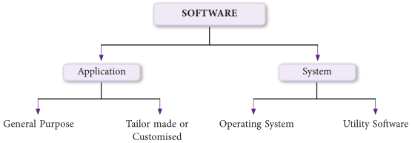

Slide 6
Types of software
System Software
Utility Software
Operating System
Application software
Customized Software
Package Software

Slide 7
System Software
System software is a type of computer program that is designed to run a computer's hardware and application programs.
Generally the system software may perform the following functions:
Communicates with hardware devices. Controls and monitors the proper use of various hardware resources like CPU, memory, peripheral devices like monitor, printer etc.
Supports the execution and development of other application software.

Slide 8
Operating Software
The operating system (OS) is the most important program that runs on a computer.
Every computer must have an operating system that runs application programs and hardware
Computer operating systems perform basic tasks, such as
recognizing input from the keyboard
sending output to the display screen,
keeping track of files and directories on the storage drives,
and controlling peripheral devices, such as printers.

Slide 9
Operating Software
An operating system (OS) is the program that, after being initially loaded into the computer by a boot program, manages all the other programs in a computer.

Slide 10
Utility programs
A program that performs a very specific task, usually related to managing system resources.
helps the user in system maintenance tasks and in performing tasks of routine nature.
Utility programs help the users in disk formatting, data compression, data backup, scanning for viruses etc.

Slide 11
Application Software
Applications software (also called end-user programs) include such things as database programs, word processors, Web browsers and spreadsheets.

Slide 12
Package Software
It is a type of application software that is developed for sale to general public
It is also known as off the shelf software.
Enables the people to perform daily activities
Developed by expert programmers
Examples
MS OFFICE
CORAL DRAW
ADOBE PHOTOSHOP
AVG antivirus etc

Slide 13
Customized Software
It is a type of application software that is designed for particular customer or organization
Developed to meet exact requirements of particular customer or organization
Developed by single programmer or a team of programmers
More costly than package software
Example
Software developed for university

Slide 14
Assignment
Device driver
Freeware
Shareware
Adware
Malware
Operating System types

Slide 15
Hardware

Slide 16
Hardware
Computer hardware refers to the physical parts of a computer and related devices.
Internal hardware devices include motherboards, hard drives, and RAM.
External hardware devices include monitors, keyboards, mice, printers, and scanners.

Slide 17
Assignment
Difference between software and hardware

Slide 18
Computer Network

Slide 19
Computer Network
A computer network is a group of computer systems and other computing hardware devices that are linked together through communication channels to facilitate communication and resource-sharing among a wide range of users.

Slide 20
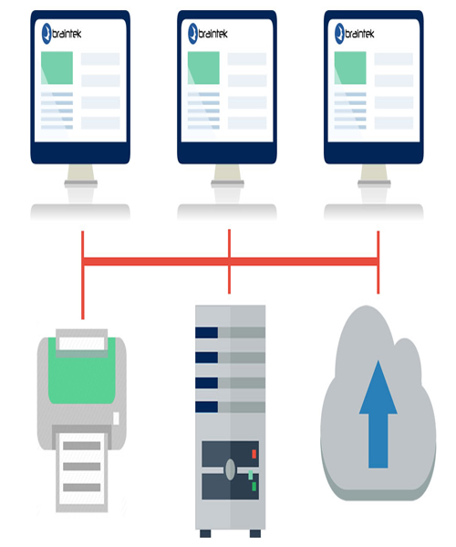
For example,
a business might use a computer network connected via cables or the Internet in order to gain access to a common server or to share programs, files and other information.

Slide 21
Network Components
Network Interface Cards (NIC)
A network interface card (NIC) is a computer circuit board or card that is installed in a computer so that it can be connected to a network.
Hubs
A hub, also called a network hub, is a common connection point for devices in a network.
E.g. USB hub, which allows multiple USB devices to be connected to one computer
Bridges
A network bridge helps to join two otherwise separate computer networks together to enable communication between them.
Repeaters
A repeater is a network device that is used to regenerate or replicate signals that are weakened or distorted by transmission over long distances
Switches
It is a high-speed device that receives incoming data packets and redirects them to their destination on a local area network

Slide 22
Types of Networks
LAN (Local Area Network)
WAN (Wide Area Network)
MAN (Metropolitan Area Network)
PAN (Personal Area Network)

